Slide 1


Content Detection
Using Apache TIKA
Name :- Sant Kumar
Program :- MCA
Enrolment No. :- 210160307012
Data Resolve Technologies

Slide 2
Abstract
Content detection involves using the Apache Tika framework to extract metadata and content from a variety of file formats including text documents, TXT, PDF, and HTML,etc. The framework is designed to automatically detect the language of the given document,It can also detect the type of the data the document is in and the specific Multipurpose Internet Mail Extensions (MIME) using the MIME Detection Mechanism. It is capable of extracting the text and metadata of the given document(s).

Slide 3
DFD for content detection using Apache Tika
Input: The input to the system is a file that contains content to be analyzed and detected. This file can be in various formats, such as PDF, Word, HTML, or Txt.
Apache Tika Parser: The file is processed by the Apache Tika parser, which extracts the content from the file and converts it to a plain text format.
Text Analysis Module: The plain text content is then passed to the text analysis module, which analyzes the content using various algorithms and techniques to detect specific patterns or characteristics that are indicative of the content in question.

Slide 4
Content Detection Module: Based on the results of the text analysis, the content detection module identifies whether the content contains certain types of content, such as explicit or offensive material, copyrighted material, or specific types of objects or activities which is categorized as the sensitive content or violated content.
Output: The output of the system is a report that indicates the detailed information of the violated or sensitive content.
User Interface: The user interface allows the user to upload files to be scanned/analyze and configure the rule to feed the algorithms on case to case basis as per our custom requirements in order to analyses the data for sensitive content.

Slide 5
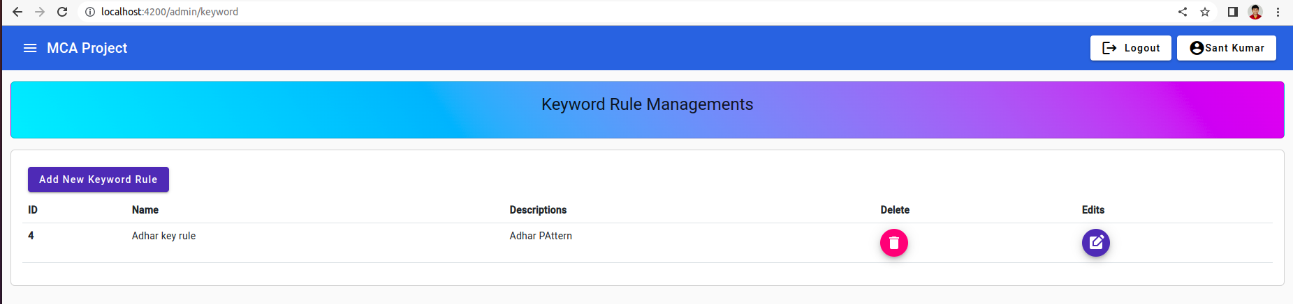
Content Scanning

Slide 6
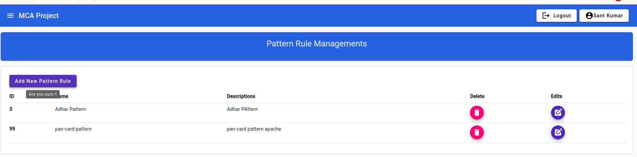

Slide 7
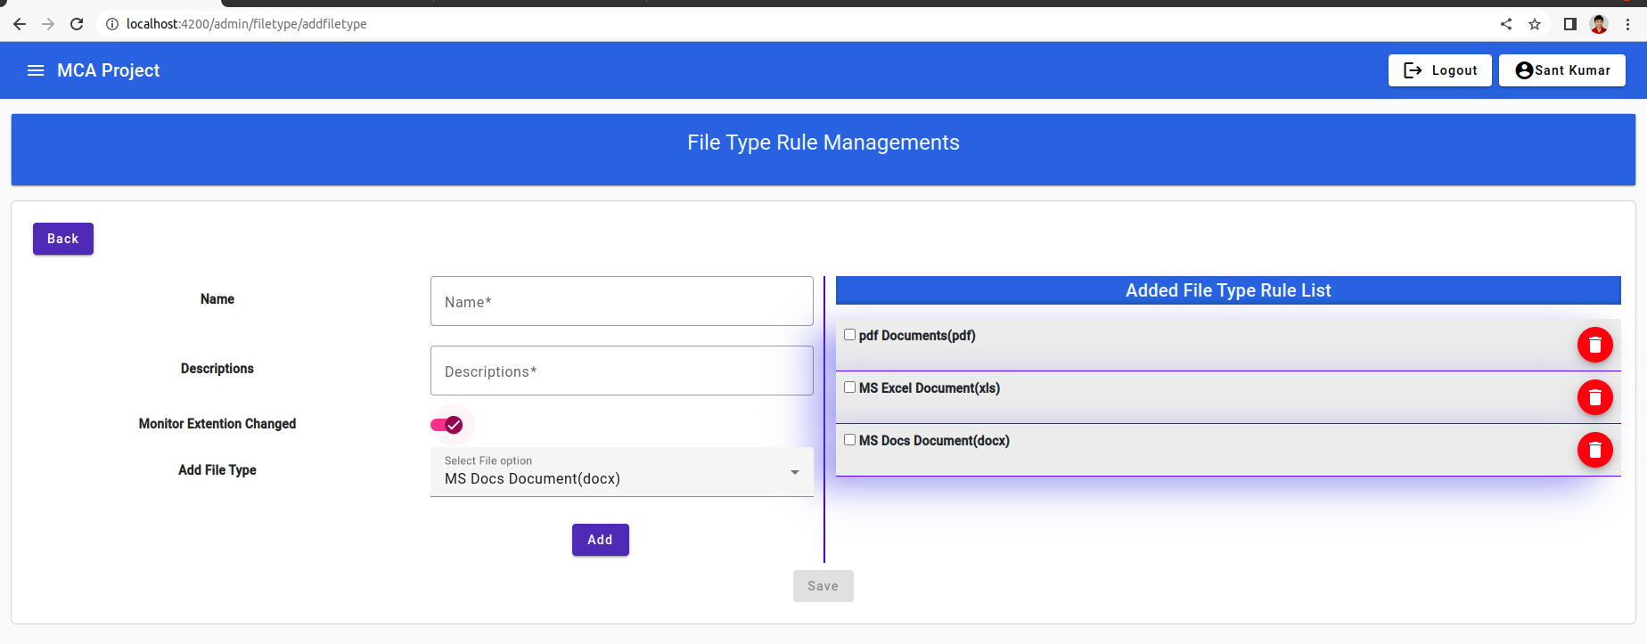

Slide 8
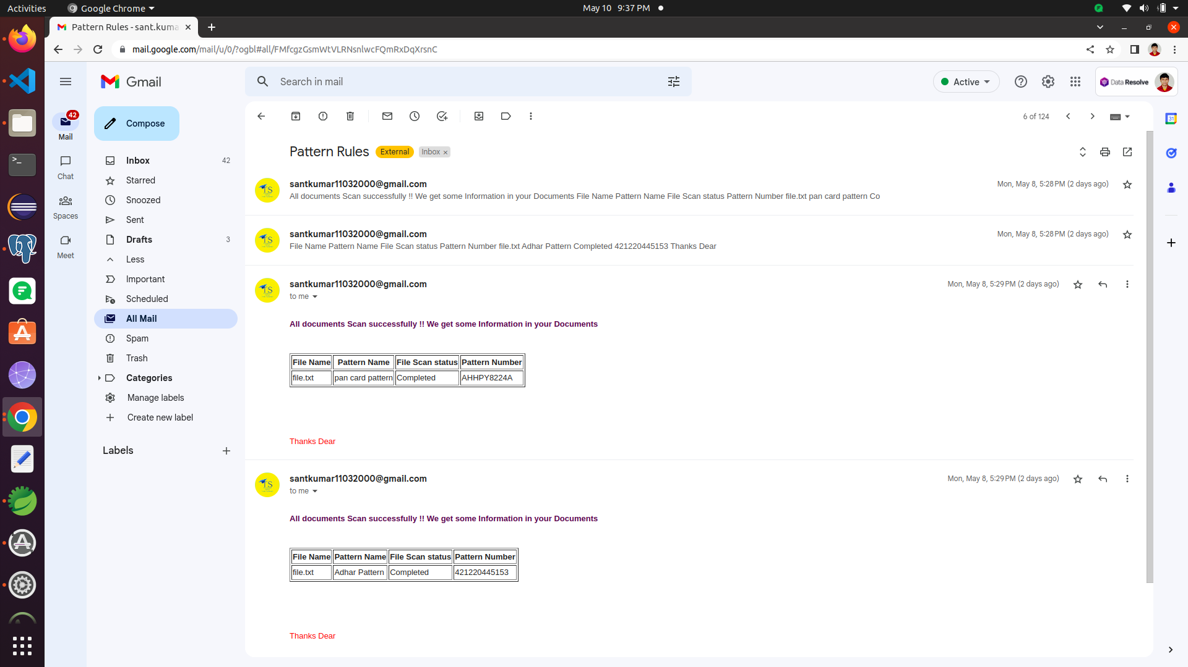
Send Mail
For violations

Slide 9
Features of content detection
File format detection: The ability to automatically detect the file format of a given file, such as a Pdf, Docs, Txt etc.
Metadata extraction: The ability to extract metadata from a file, such as author, date, and language.
Content extraction: The ability to extract content from a file, such as text,Pdf, and Docs.
Scalability: The ability to handle large volumes of content and perform content detection quickly and efficiently.
Accuracy: The ability to accurately detect and identify specific types of content, while minimizing false positives and false negatives.
Flexibility: The ability to be customized and adapted to different use cases and environments.

Slide 10
Technologies Used
HTML
CSS
Bootstrap
Spring Boot
Angular
Spring Data JPA
Spring Security
JSON Web Token
Angular Material
Apache Tika
JSON
Server: Tomcat Server
Database: PostgreSQL

Slide 11
Thank You

